Slide 1
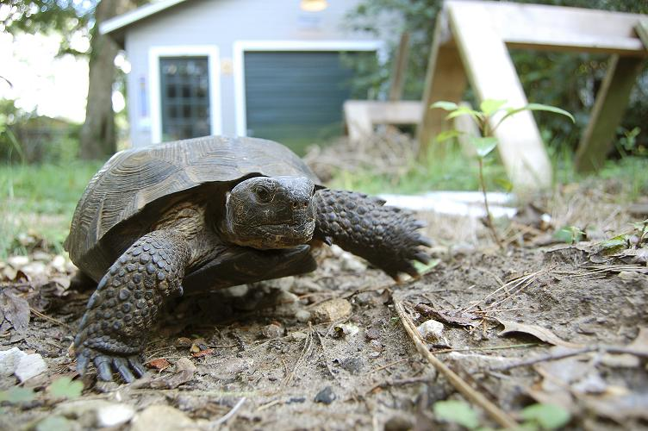
Meet the Gopher Tortoise!

Slide 2
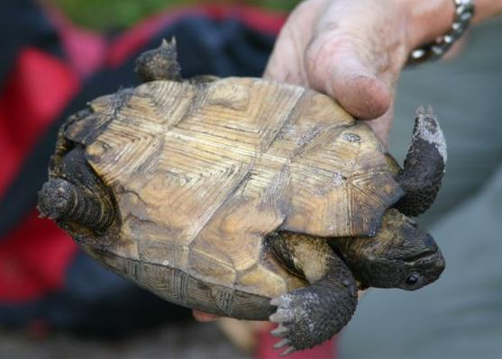
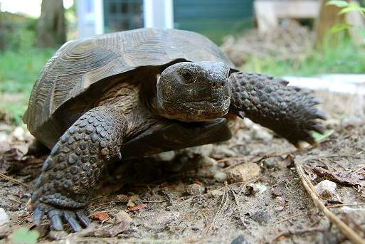
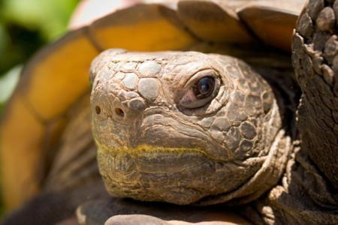
Identification
Stumpy back legs
Shovel like front feet
Broad head with non-projecting snout
Notes:
Shovel like front feet and stumpy elephant-like back legs
Broad head with non-projecting snout

Slide 3
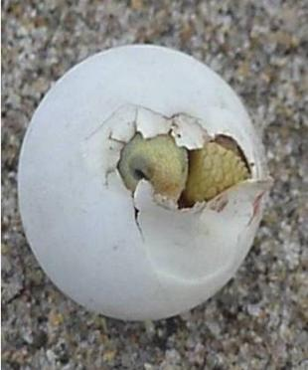
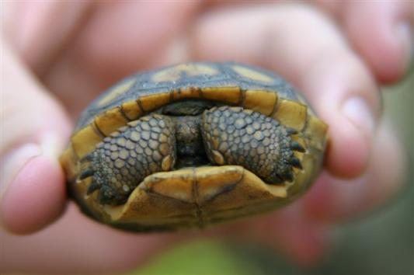
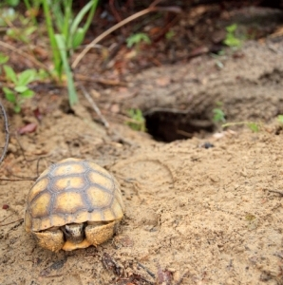
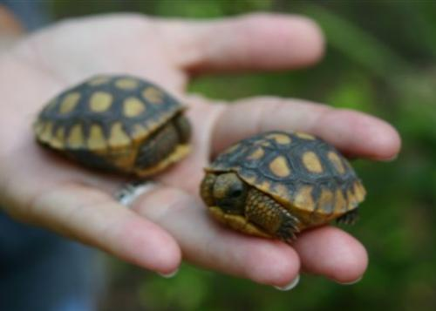
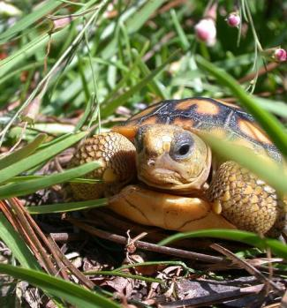
Juvenile gopher tortoises
Notes:
The gopher tortoise is the only land tortoise native to Florida though may not be the only one encountered in the wild
Juveniles have a yellow/orange color. Juveniles can use an existing burrow or dig their own small burrow.

Slide 4
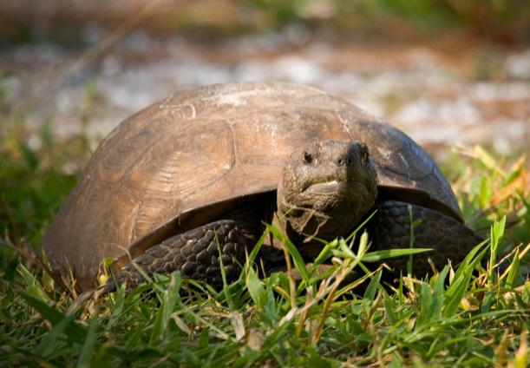
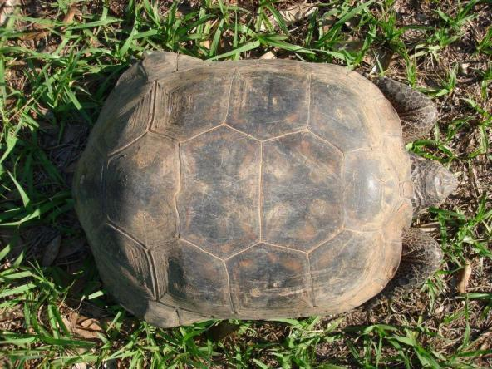
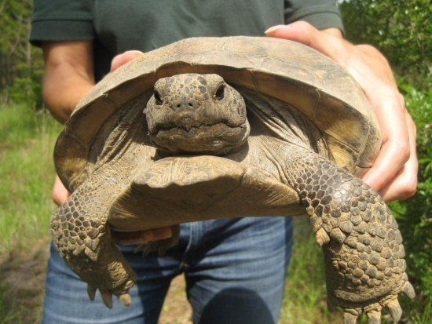
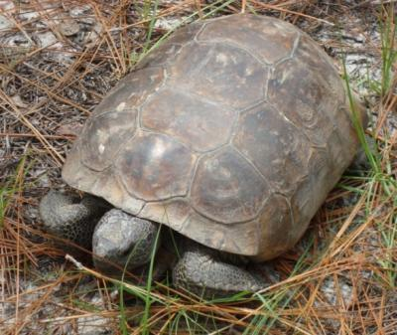
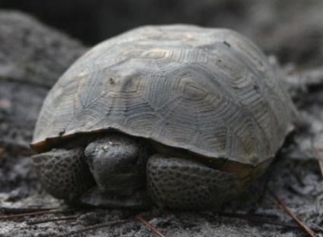
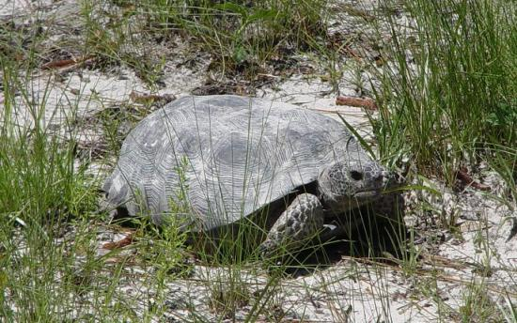
Adult gopher tortoises
Notes:
Adults have a gray brown color, can weigh 15 pounds and average nine to eleven inches long, but some grow to 15 inches in length.

Slide 5
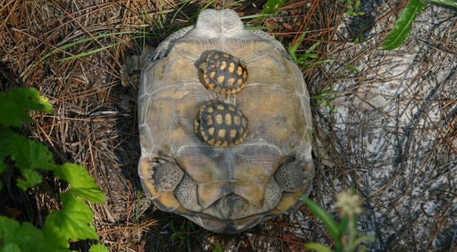
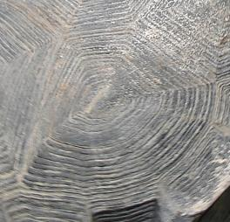
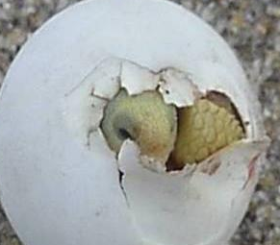
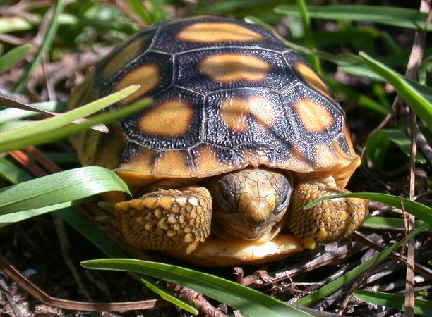
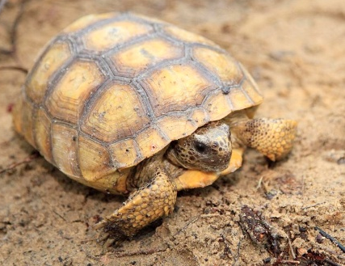
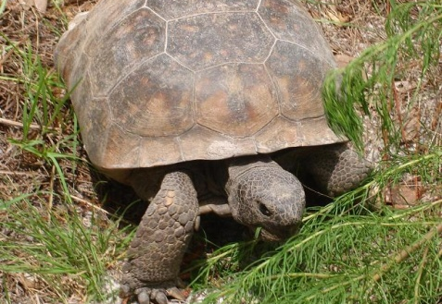
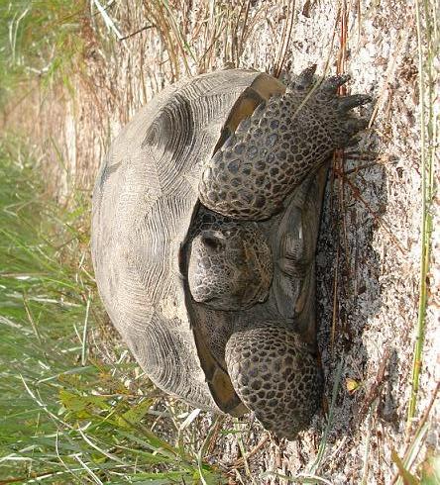
How old is the tortoise? How long will it live? How big will it get?
Scute annuli are added with food intake, not yearly thus cannot be used to determine age.
Scute annuli
You can estimate tortoise age depending on their size and stage of life…….the
SIZE/AGE CLASS. Their average life span is 50+ years. Oldest known is 83 yrs.
NEONATE 32-55 mm 2 d - 2 wks | HATCHLING 35-68 mm 2 wks - 3 yrs | JUVENILE 53-81 mm 2-10 years | SUBADULT 82 (130)-180 mm 10 – 20 years | ADULT 181 – 387 mm 15 - 80+ years
Soft shell Egg-tooth Yolk sac | Flexible shell, skin yellow, carapace high domed | Skin darkening, shell flattened but flexible | Shell hardening, color becoming uniform, skin dark | Shell very hard, color uniform gray to brown and skin dark
Notes:
Notice the difference in size between the upside down adult tortoise and the hatchlings shown in the upper right photograph. Is the adult a male or female? (male). Identification of age is only definite if the tortoise was followed from hatching to adulthood. Otherwise, the age is only a guess. Don’t be confused because the size and ages seem to overlap; remember that a child of twelve can be 4 ft. to 6ft. tall depending upon individual genetics and nutrition. Scutes are tough skin that grows over the bone from the center outward in rings (annuli). Early studies on tortoise growth believed that the annuli (growth rings on scutes) were added yearly like tree rings and could be used to tell the age. This is not the case according to recent research that confirmed that growth rings are sometimes added at rates of 2-3 or more a year depending upon the available food supply. This rate is so variable that no method for determining a “factor” ( such as 1.5 rings per year) has been found accurate to use with the rings as an aging method. The concept of size/age classes is used to quantify data. Size classes and age classes may overlap and must be used in conjunction with the other characteristics such as color of shell and skin, hardness of shell, amount of dome-shape to carapace, and behaviors. Size/age class is also important because it has to do with the number of tortoises which count in a relocation – only those over 130mm (subadults and adults) are counted towards the FWC permitted total of tortoises for relocation. All tortoises of all size/age classes are to be relocated even though only the subadults and adults count towards the total.

Slide 6
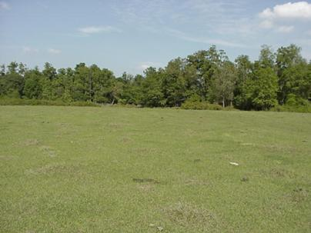
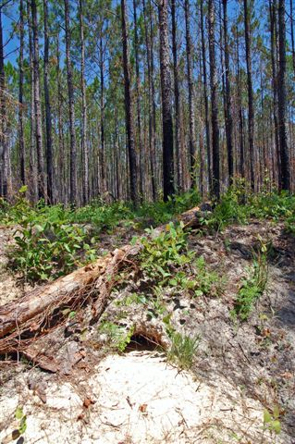
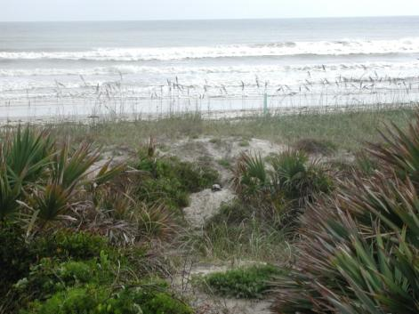
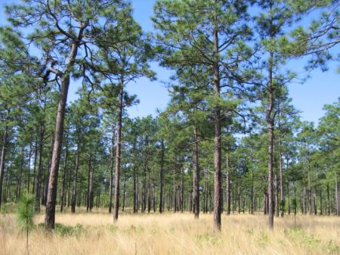
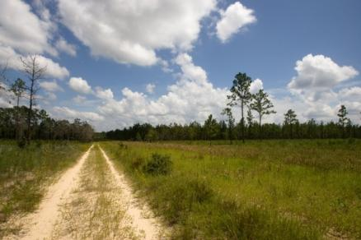
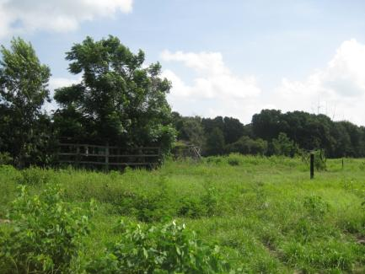
Where do gopher tortoises live?
Notes:
Gopher tortoises occur in all 67 counties in Florida, but prefer high, dry, sandy places such as longleaf pine and xeric oak sandhills. They also live in scrub, xeric hammock, pine flatwoods, dry prairie, coastal grasslands and dunes, mixed hardwood-pine communities, and a variety of disturbed habitats, such as pasture lands. The biggest threat to their long-term survival is loss of habitat.

Slide 7
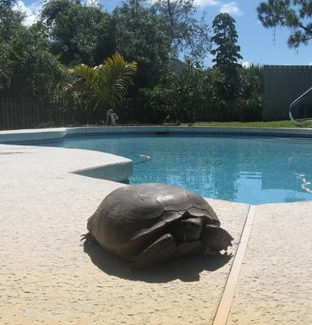
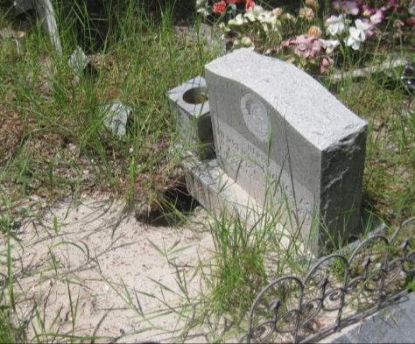
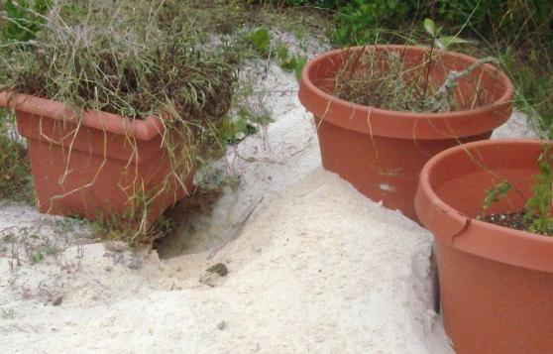
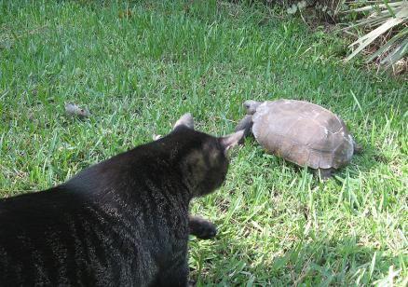
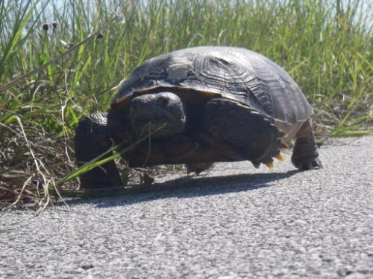
Where else do we find them?
Notes:
Gopher tortoises occur in all 67 counties in Florida, but prefer high, dry, sandy places such as longleaf pine and xeric oak sandhills. They also live in scrub, xeric hammock, pine flatwoods, dry prairie, coastal grasslands and dunes, mixed hardwood-pine communities, and a variety of disturbed habitats, such as pasture lands. The biggest threat to their long-term survival is loss of habitat.

Slide 8
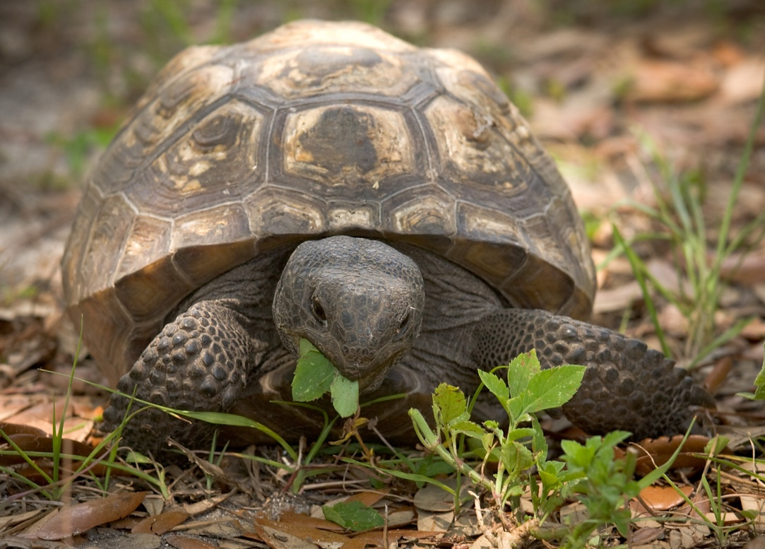
What do they eat?

Slide 9

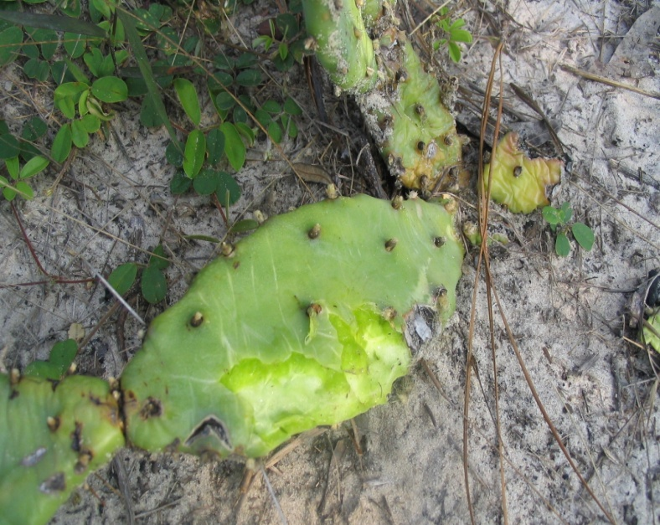
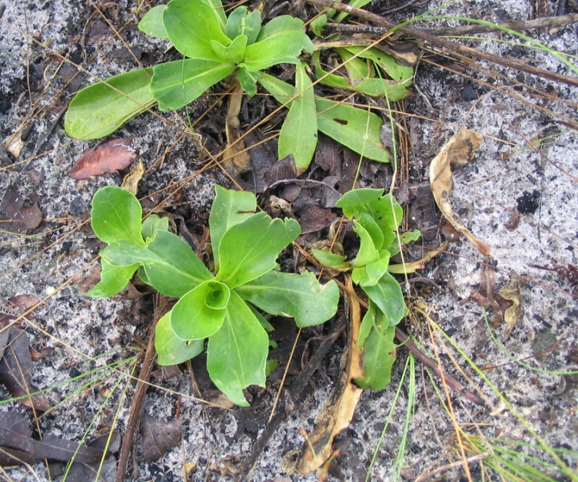
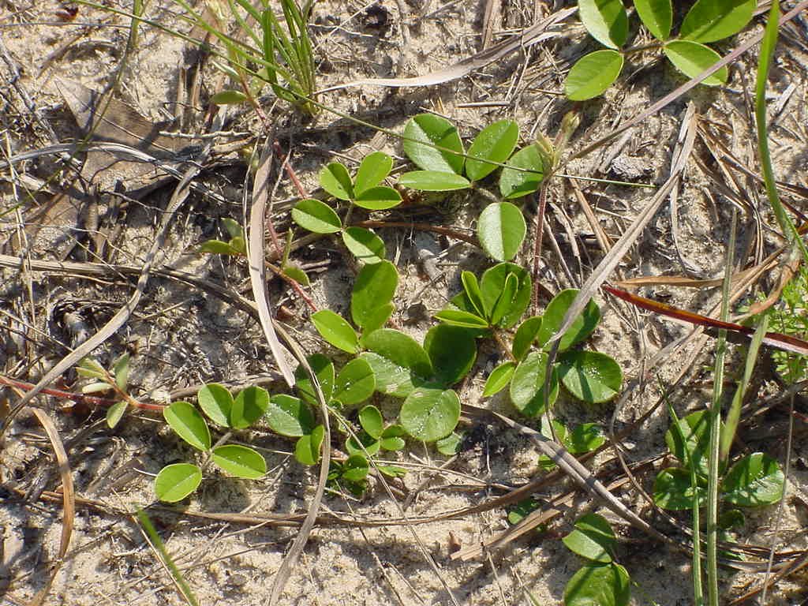

What do tortoises eat?
Not all plants are “FORAGE” species. Gopher tortoises
have preferences for certain plants at certain times.
2
1
3
Seasonally, tortoises may eat only the shoots, leaves, flowers or fruits; but sometimes they pull the entire plant up and consume it roots and all. 80% of their diet is grasses.
4
Notes:
Not all plants are “FORAGE” species – tortoises have preferences for certain plants and will go long distances to find them but there are some species they just taste and others they do not eat at all (see the plant list in the Information Package). Forage species shown here include Opuntia or prickly pear cactus pads (#1), the tender basal leaves of Carphephorus or paint brush (#2), the leaves and stems of Eupatorium or dog fennel (#3), and leaves of Galactia or milk pea (#4). Tortoise eat almost all kinds of grasses, unless they are very tall or very tough. Some grasses they only eat when the grass just comes up like wire grasses. 80% of the actual biomass (physical material) that they eat is composed of grasses and grass-like plants such as sedges and rushes. The other 20% is made up of a great diversity of flowering plants, ferns, and even lichens and mushrooms. They seasonally eat fruits like blueberries, blackberries, wild grapes, cactus fruits, pea or bean pods, pawpaw, gopher apple, coco plums, passion fruits, persimmons, elderberries, and other fruits that fall from trees like wild cherries. They also will eat flowers, young shoots, tender young leaves, and cactus pads. Tortoises rarely eat tubers but they will rip up entire plants like #4 – the Milk Pea and consume the entire vine, roots and all. The list of forage plants that tortoises eat (Ashton and Ashton 2008) exceeds 500 species with most tortoises encountering between 150 and 450 species each year, depending upon their specific habitat. Scrub has very few forage species and sandhills have a tremendous diversity of forage species. The cactus pads in #1 were eaten by an adult tortoise while the tiny bites in the basal leaves of the paint brush (has pink flowers) were made by a hatchling tortoise while the photographer watched. The milkpea (Galactia) vine in #4 is a favorite of the tortoise. When tortoises are confined in a recipient site preserve and do not have the choice to travel long distances to find the foods they need, it is important to make sure there are a great diversity of forage species available. Tortoises like the plants found in yards (because yards are mostly grasses and small flowering plants (weeds) that they like to eat. Tortoises often find species they like on roadsides and in open pastures as well as in their more natural habitats.

Slide 10
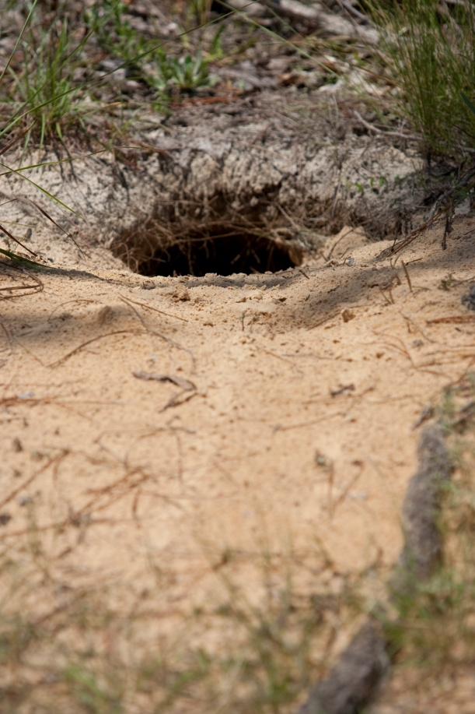
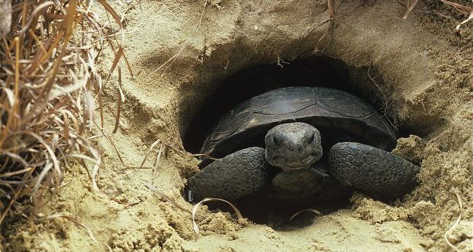
The burrow
7 feet deep and can reach more than 15 feet long!
A tortoise can have more than one burrow
A tortoise burrow looks like a half moon.

Slide 11
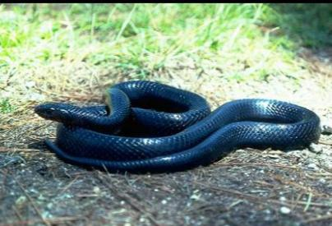
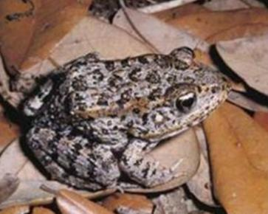
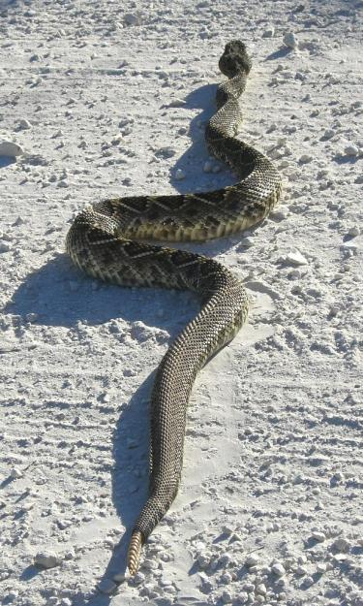
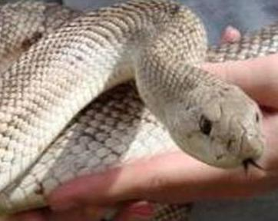
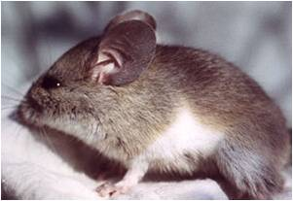
Burrow buddies
Indigo snake
Florida pine snake
Gopher frog
Florida mouse
Diamondback rattlesnake
Notes:
These species who depend upon tortoise burrows are called commensals and include the indigo snake, pine snake, gopher frog, opossum, burrowing owl, Florida mouse, gopher cricket and scarab beetle.

Slide 12

Now lets take a closer look!
Notes:
Examples: A variety of GT artifacts, field trip outside or live gopher tortoise

Slide 13
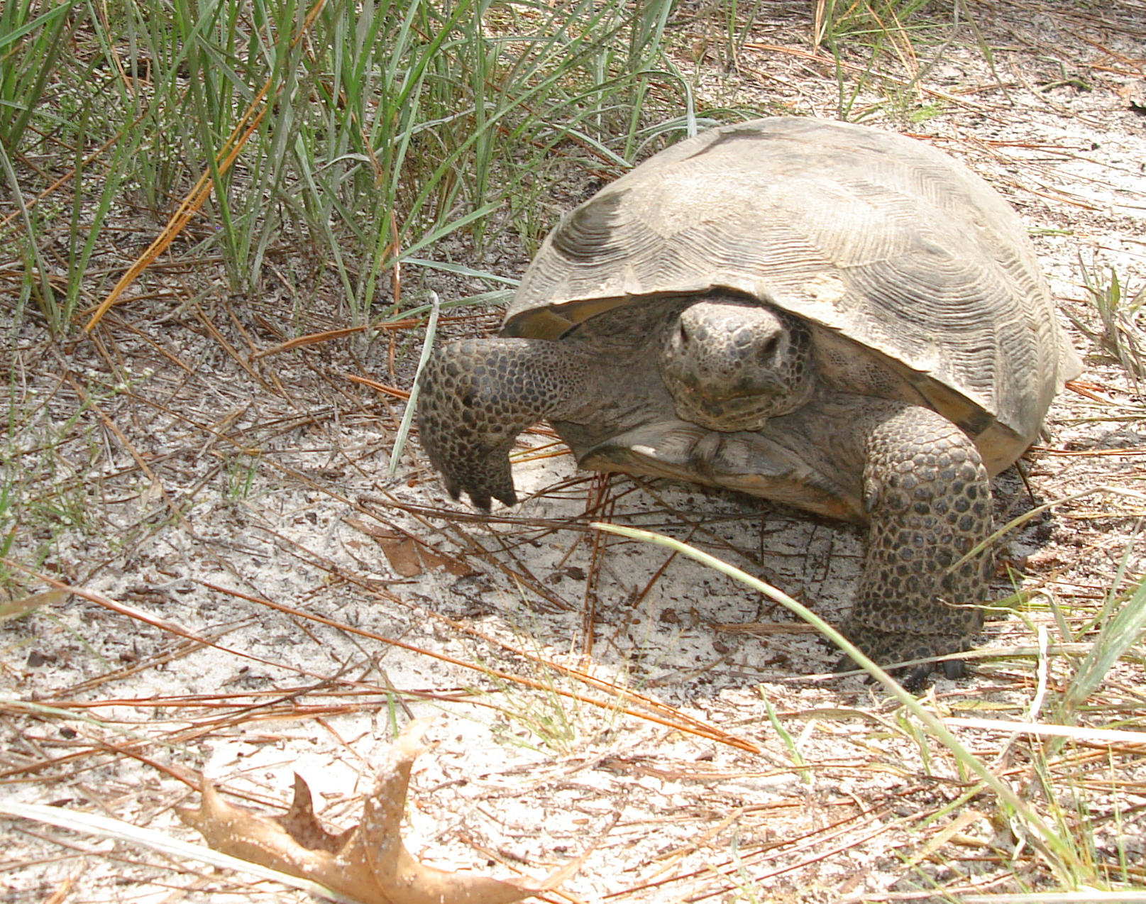
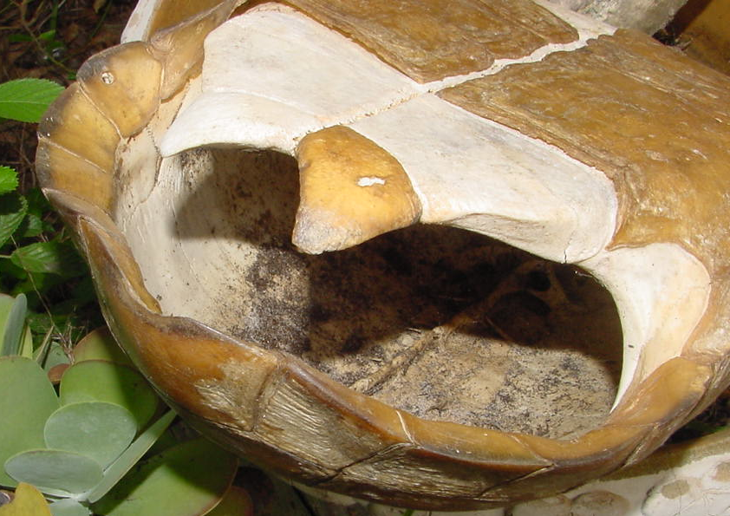
Anatomy of an adult tortoise
Tortoises have scaly muscular feet with strong claws for digging in and walking on sand. The shell is part of the body – it is bone covered with skin (scales or scutes) and is attached to internal organs.
Tortoises can be bigger than a dinner plate with a carapace length of 12-14 inches (300-350mm).
Carapace
Nuchal scute
Marginal scutes
Plastron
Anal scute
Gular scute
Nares
Mental gland
Vertebrae or backbone
Exposed bone - scales missing
Carapace
Notes:
Knowledge of the external anatomy of a gopher tortoise is helpful when trying to describe the identification of males from females and the actions and behaviors of a tortoise. The top shell, (see the shell on the bottom left-shown upside down) made of bone and covered with dermal (skin) derived scales is called the CARAPACE. The carapace is fused to the backbone or vertebral column. The body and organs are permanently attached to the carapace and plastron. The PLASTRON is the underside of the shell which is attached to the carapace on both sides by the bridge, also made of bone and covered by dermal scales called scutes. The scutes are all named but the ones we talk about when measuring or marking the tortoise are named here. In the front of the carapace is a triangular scute called the Nuchal (pronounced new-cal) scute and at the rear of the carapace is the anal scute. When measuring the straight line carapace length (CL) of the tortoise, calipers are placed on the anal and nuchal scutes. The marginal scales are used to mark tortoises using the Cagle system which we will discuss later. The Gular scute of the plastron is often much longer in males and can be used to help “post” the tortoise when they are digging their burrows and it also can be used to ram or flip another tortoise over. The flattened (paddle-like) muscular front feet have strong claws and are used for digging the burrow as well as moving rapidly across sand and climbing over logs, up rocky ridges and through thick vegetation. The hind feet (not shown here) are rounded and elephant like, designed to provide a platform for lifting the forward part of the body during digging, mating and climbing. The head includes two nasal openings called NARES and two glands visible below the chin called MENTAL GLANDS which contain pheromones used in courtship and mating. (This slide can be used later like a transparency to have students copy the identification terms on to a copy of a tortoise diagram from the teacher information package.)

Slide 14
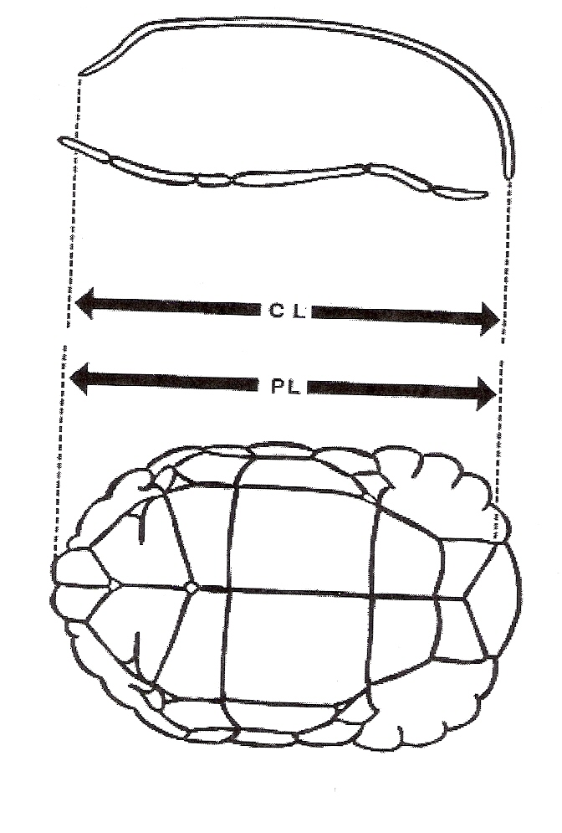
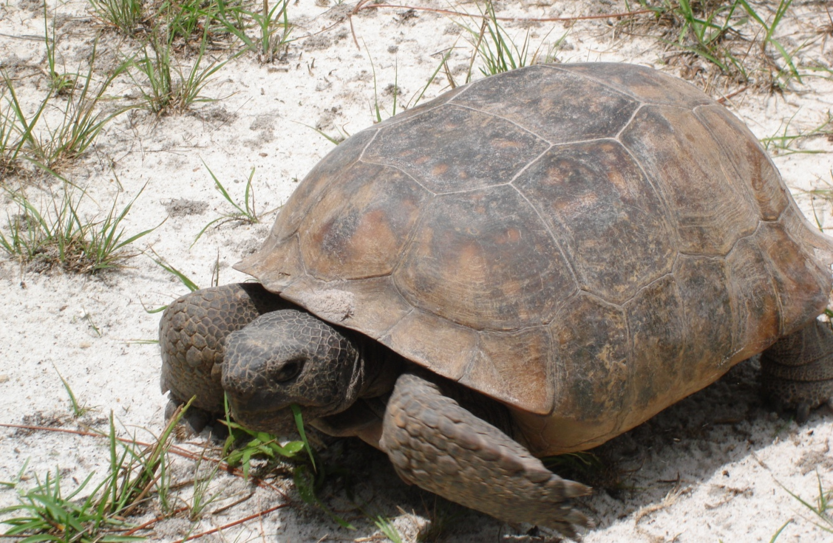
More about gopher tortoises…
CARAPACE
PLASTRON
DO YOU REMEMBER THE NAMES OF THESE BODY PARTS?
1?
2?
3? 4?
5? 6? 7?
Tortoises can be bigger than a dinner plate with a carapace length of 12-_?_ inches (300-350mm)
Terminal marginal
BRIDGE ANAL SCUTES CL = Carapace length
MARGINAL SCUTES PL = Plastron Length
GULAR SCUTES
Notes:
Can you remember the names of the external (outside) anatomy of the tortoise? Number 1 is the – top shell or carapace with dermal scales; Number 2 shows the edge scales or MARGINAL SCUTES; Number 3 is by the head with the NARES or nostrils on the front (mental glands are under the chin and not visible here); Number 4 is on the part called the BRIDGE that joins the bottom shell or PLASTRON with the top shell or CARAPACE; Number 5 is the flattened scale covered front leg and foot with strong claws for digging; Number 6 is pointing to the underside or PLASTRON; Number 7 is pointing to the elephant-like hind leg. Did you wonder how BIG a tortoise can get? Well some can be as large as a dinner plate 12-14 inches for the CL (carapace straight line measurement-meaning we don’t bend the ruler to match the shape of the shell but instead use calipers to take the measurement). The diagram on the left shows the official FWC way of measuring the carapace CL from nuchal scute in front to tip of the terminal marginal scute in back and the proper way to measure the PL or plastron straight line measure from the gular scute in the front to longest tip of one of the anal scutes at the rear.

Slide 15
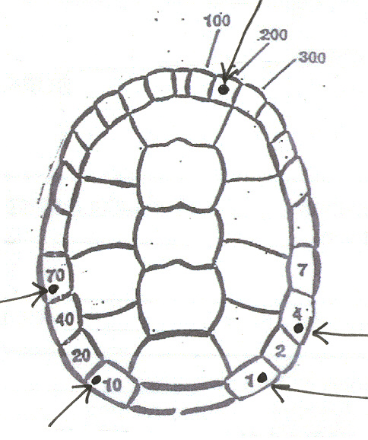
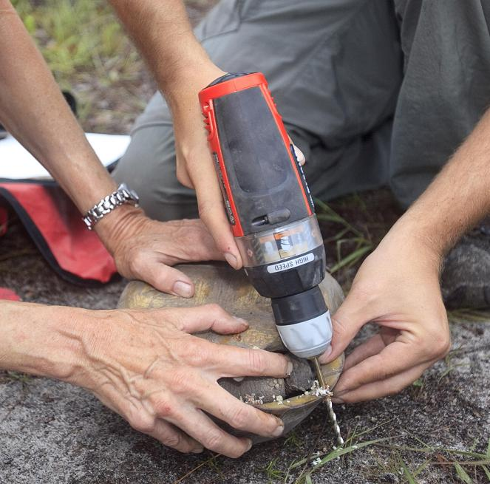
How do scientists know which tortoises are which? By using the Cagle method.
A data sheet is
completed when
tortoises are captured. The specimen number can be on a microchip placed in the hind leg or can be drilled into
marginal scutes.
Each tortoise is given a number using the Cagle method so the data can be recorded when they are re-captured. What is this tortoise’s number?
Notes:
Scientists need to be able to identify individual tortoises in order to study their habits, movements, reproduction and foraging needs. They can be identified by using the Cagle Method which includes drilling small holes in the marginal scutes (much like putting a hole in your finger nail) to match a numbering system. Filing a “v” with a triangular wood file has been done but sometimes the action of filing causes the bone to break off or can go too deep and lead to infection. The drilling method has, over time, proven to be the safest and best method. Here you see FWC scientists holding the tortoise securely, as the tortoise pulls its legs and head inside its shell. Sometimes a large tortoise is placed with the carapace up and plastron resting on a holding device that also safely positions it for drilling. Either position allows it to be marked without causing other injuries. You see the drill bit passing smoothly through the marginal scute. The holes are drilled to match the diagram and numbering system invented by Cagle. The number of this tortoise is 285 (made by drill the 200, then the 70+10 and then the 4 + 1). Another method of marking is to insert a pit tag or microchip subdermally into the upper part of the hind leg. This rarely causes any problems but you do have to have a device to “read” the chip (You can have students use the Cagle method to mark the tortoise model they make when doing the activity called “Build a Gopher Tortoise – Anatomy and Daily Needs” except they will use a single hole punch on their paper tortoise instead of a drill).

